Slide 1


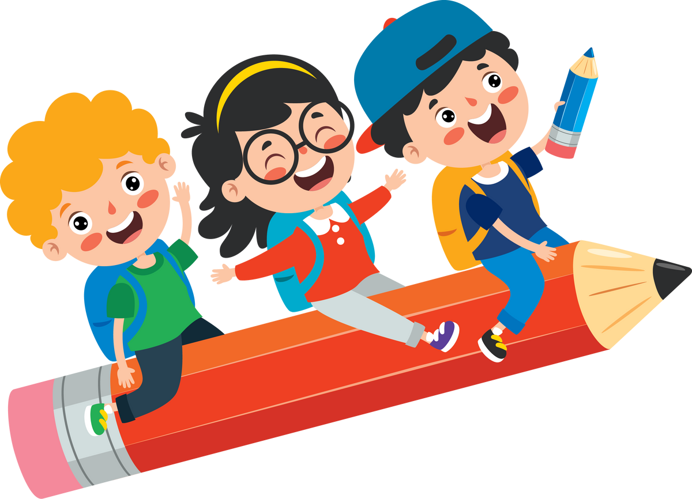



Celebrating
WORLD
BOOK
DAY

Slide 2

Mystery Covers!
On the next few pages you will see a series of book covers, but there’s a catch! They’ve all been altered in some way and your challenge is to work out what popular book cover is being shown!

Slide 3

How it works...
your teacher will decide whether you work individually or in teams. here’s a few things to consider...
will children write the answers down, or have a ‘buzzer’ to buzz in when they think they know?
is calling out the answer allowed?
are questions or hints allowed?
will they work in teams, pairs or individually?

Slide 4

Example round
Click for a hint

Slide 5
Example round
Click for a hint
the main character is a favourite pet...

Slide 6
Example round
and the answer is...

Slide 7

Example round
And the answer is...

Slide 8

Are you ready to begin?
There’s 10 book covers... here goes!

Slide 9

Round 1
Click for a hint

Slide 10
Round 1
Click for a hint
They gave up...

Slide 11

Round 2
Click for a hint

Slide 12
Round 2
Click for a hint
a surprising visitor

Slide 13

Round 3
Click for a hint

Slide 14
Round 3
Click for a hint
a minibeast of many uses...

Slide 15

Round 4
Click for a hint

Slide 16
Round 4
Click for a hint
not a very nice boy...

Slide 17

Round 5
Click for a hint

Slide 18
Round 5
Click for a hint
A tasty vegetable...

Slide 19

Round 6
Click for a hint

Slide 20
Round 6
Click for a hint
Three animals...

Slide 21
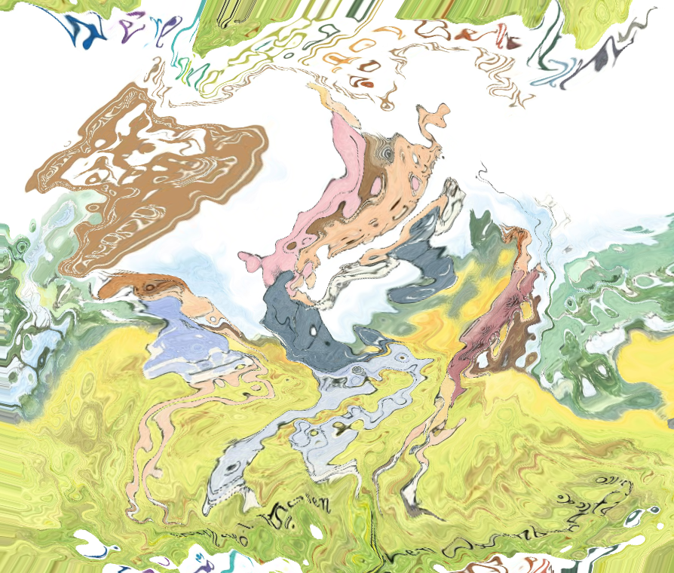
Round 7
Click for a hint

Slide 22
Round 7
Click for a hint
off to catch a big one!

Slide 23

Round 8
Click for a hint

Slide 24
Round 8
Click for a hint
She’d love world book day!

Slide 25

Round 9
Click for a hint

Slide 26
Round 9
Click for a hint
it really wants to eat something...

Slide 27

Round 10
Click for a hint

Slide 28
Round 10
Click for a hint
an animal in clothing

Slide 29
Round 1
and the answer is...

Slide 30
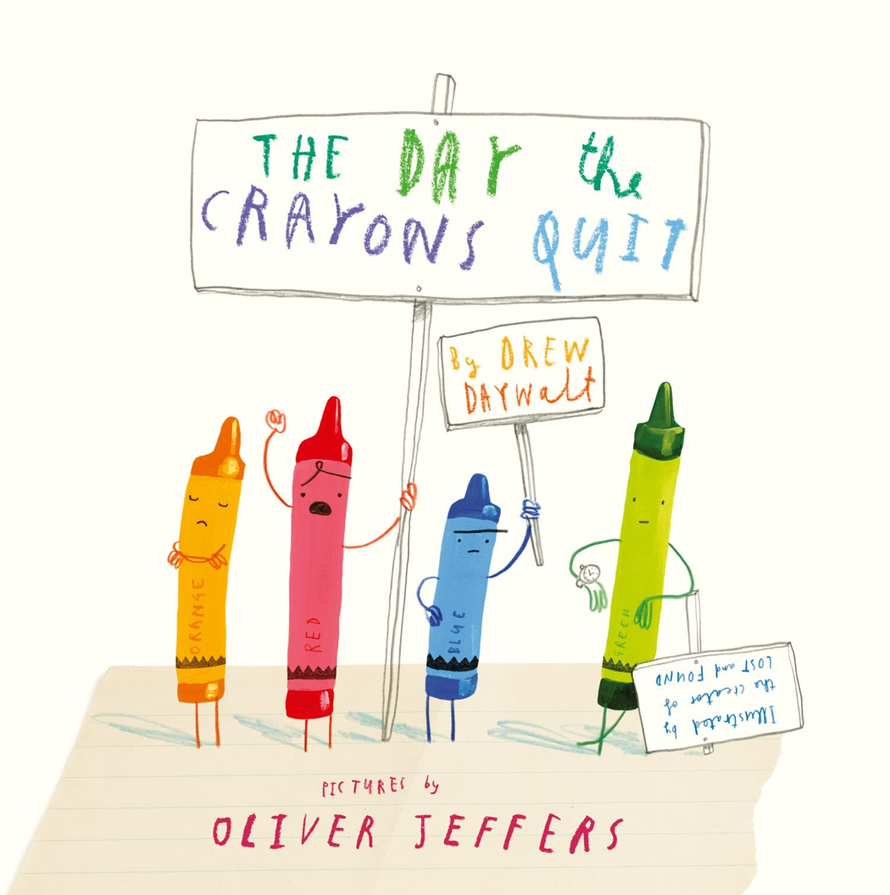

Slide 31
Round 2
and the answer is...

Slide 33
Round 3
and the answer is...

Slide 34


Slide 35
Round 4
and the answer is...

Slide 37
Round 5
and the answer is...

Slide 38


Slide 39
Round 6
and the answer is...

Slide 40


Slide 41
Round 7
and the answer is...

Slide 42


Slide 43
Round 8
and the answer is...

Slide 44


Slide 45
Round 9
and the answer is...

Slide 46


Slide 47
Round 10
and the answer is...

Slide 48


